Slide 1
Faculty of Medicine
University of Ruhuna

Slide 2
Introduction to Information Systems of the Faculty of Medicine.
D.D.J Withana (B.Sc. col, M.Sc. col)
Computer Programmer & System Analyst
Faculty of Medicine
University of Ruhuna.

Slide 3
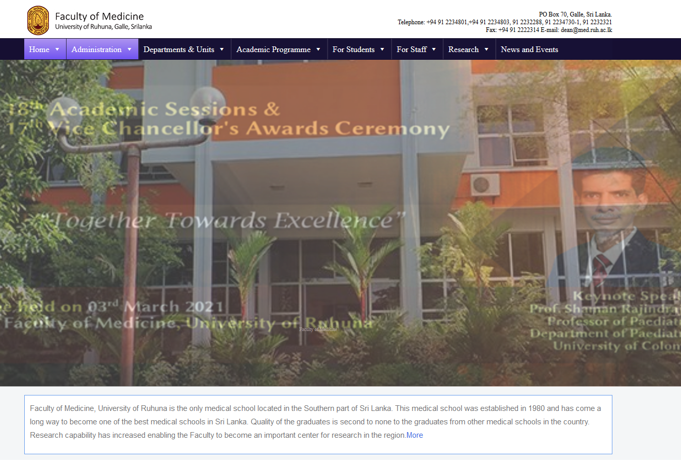
Website
http://www.medi.ruh.ac.lk/

Slide 4

Distance Learning

Slide 5
Solution
Learning Management System (LMS)
Zoom
Faculty of Medicine Management Information System (FMEMIS)

Slide 6
Introduction to LMS

Slide 7
Learning Management System
  A learning management system (LMS) is a software application for the administration, documentation, tracking, reporting and delivery of educational courses or training programs.

Slide 8
List of application-Proprietary
Blackboard Learning System
CERTPOINT Systems Inc.
Desire2Learn or Brightspace
eCollege
Edmodo
EduNxt
Engrade
GlobalScholar
Glow (Scottish Schools National Intranet)
HotChalk
JoomlaLMS
Kannu
Latitude Learning LLC
SAP
Schoology
Skillsoft
Spongelab
SuccessFactors
SumTotal Systems
Taleo
Uzity
WizIQ

Slide 9
List of application-Cloud base
CallidusCloud
Cornerstone OnDemand Inc.
DoceboLMS
EthosCE
Google Classroom
Grovo
Growth Engineering
Halogen Software
Inquisiq R3
itslearning
Kannu
Latitude Learning
Litmos
Udutu
WizIQ

Slide 10
List of application-Open source
aTutor
Canvas
Chamilo
Claroline
eFront
ILIAS
LAMS
LON-CAPA
Moodle
OLAT
OpenOLAT
Sakai
SWAD
WeBWorK

Slide 11

Moodle
Moodle is a free and open-source learning management system (LMS) written in PHP and distributed under the GNU General Public License.[5][6] Developed on pedagogical principles,[7][8] Moodle is used for blended learning, distance education, flipped classroom and other e-learning projects in schools, universities, workplaces and other sectors.[

Slide 12
How to access Faculty of Medicine LMS?
Refer direct link
  http://www.lms.medi.ruh.ac.lk
Or access Faculty of Medicine main web
  http://www.medi.ruh.ac.lk/ and select the “For student” in menu

Slide 13
Minimum Requirement
Computer with internet connection

Slide 14
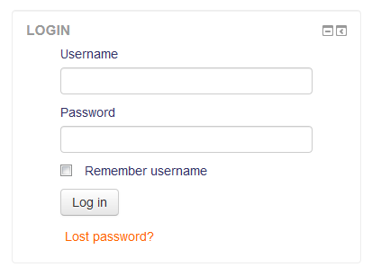
Log in to the system

Slide 15
Login Details
Username (ex:)
  If Registration Number MD/2025/8500
  Username will be md8500
Password
  Med43@2020_Pwd

Slide 16
Login Details (cont..)
Username:
  Ex: MD/2025/8500 -> md8500
Password:
  Med43@2020_Pwd

Slide 17
Change Password
Dashboard / ► Preferences
will direct you for manage your password.
  Change password

Slide 18
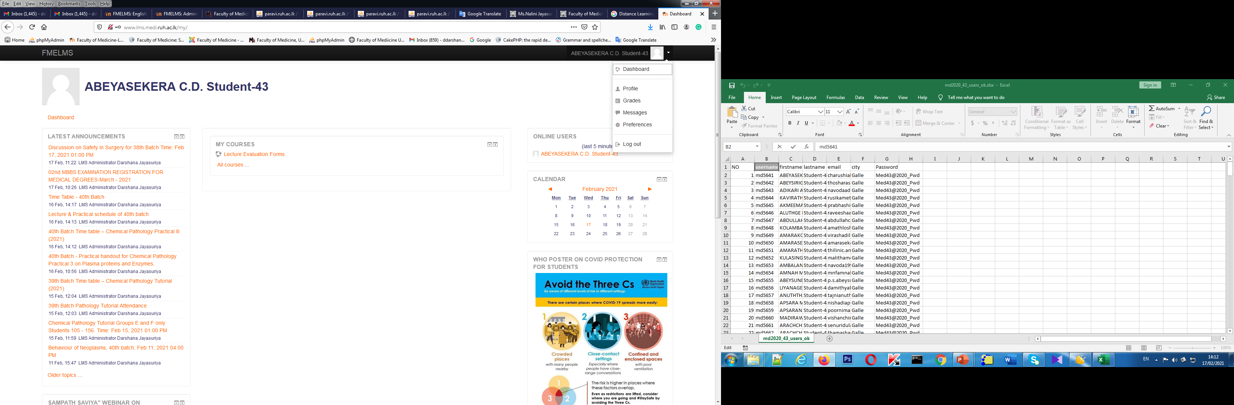

Slide 19
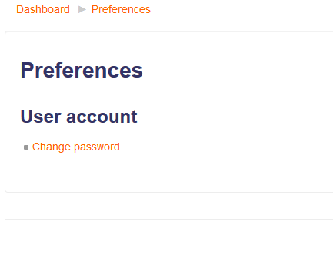

Slide 20
Course Structure for Foundation Module
  Course categories
  Undergraduate / ►
    MBBS Degree Programe / ►
    Foundation Module - 2021 -43rd Batch of Students / ►
    English Program - 2021 -43rd Batch of Students/ ►

Slide 21
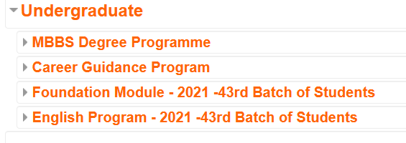
Course Structure for Foundation Module

Slide 22
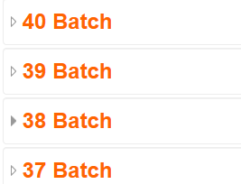
Course Structure for academic activities.
Courses / ►
  Undergraduate / ►
    MBBS Degree Programe / ►
      Department of Anatomy / ►

Slide 23
Resources
Book - Multi-page resources with a book-like format. Teachers can export their Books as IMS CP (admin must allow teacher role to export IMS)
File - A picture, a pdf document, a spreadsheet, a sound file, a video file
Folder - For helping organize files and one folder may contain other folders
Label - Can be a few displayed words or an image used to separate resources and activities in a topic section, or can be a lengthy description or instructions
Page - The student sees a single, scrollable screen that a teacher creates with the robust HTML editor
URL - You can send the student to any place they can reach on their web browser, for example Wikipedia

Slide 24
Activities
Assignments - Enable teachers to grade and give comments on uploaded files and assignments created on and off line
Chat - Allows participants to have a real-time synchronous discussion
Choice - A teacher asks a question and specifies a choice of multiple responses
Database - Enables participants to create, maintain and search a bank of record entries
Feedback - For creating and conducting surveys to collect feedback.
Forum - Allows participants to have asynchronous discussions

Slide 25
Activities more
Glossary - Enables participants to create and maintain a list of definitions, like a dictionary
Quiz - Allows the teacher to design and set quiz tests, which may be automatically marked and feedback and/or to correct answers shown

Slide 26
Zoom

Slide 27
Zoom for online teaching
https://learn.zoom.us/
  Platform based on the University system.
  300 participants
  No time limit

Slide 28
Minimum Requirement
Computer + Speaker + Mic + internet connection

Slide 29
Teacher will Publish following kind of details
Darshana/FOM is inviting you to a scheduled Zoom meeting.
Topic: Introduction to 43rd Batch
Time: Feb 19, 2021 12:00 PM India
Join Zoom Meeting
https://learn.zoom.us/j/67405569433?pwd=WHBtanNRdnArSmVXK3BQRGhGOURrQT09
Meeting ID: 674 0556 9433
Passcode: Ms#Yx$1a

Slide 30
How to connect to Zoom class room?
Method 01: Use URL
https://learn.zoom.us/j/67405569433?pwd=WHBtanNRdnArSmVXK3BQRGhGOURrQT09
Then it will ask to download and install the zoom application on your device.
Proceed it.
Then it will automatically connect to meeting or click on Launch Meeting button to connect.

Slide 31
How to connect to Zoom class room
Method 02:
First install Zoom app on your device
https://zoom.us/download
Then use
Meeting ID: 674 0556 9433
Passcode: Ms#Yx$1a

Slide 32
Important!!!!!!!!!!!!
Rename your name as Registration Number.
Your attendance will record with this.

Slide 33
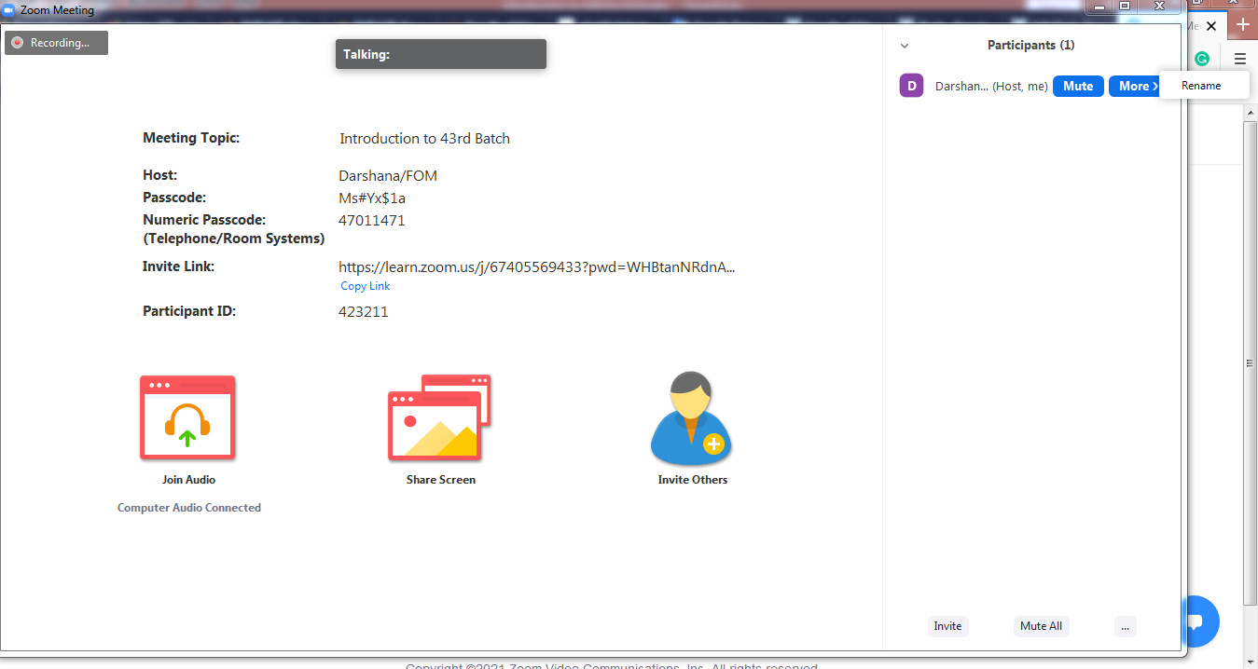
Zoom interface

Slide 34
University of Ruhuna,
Management Information System
https://paravi.ruh.ac.lk/prerumis/
Username: md202058**
Password: A/L index No

Slide 35
Faculty of Medicine Management Information System (FMEMIS)

Slide 36
FMEMIS
Usage:
  Manage student personal and academic data.
    Ex: Examination registration
    Etc.

Slide 37
Access the FMEMIS
https://paravi.ruh.ac.lk/fomemis

Slide 38
Login details
Login details will be given later.

Slide 39
Problem?
If any problem
Send email to it@med.ruh.ac.lk
With your name, registration number,
OR Call 09122*****

Slide 40
Thank You

